Slide 1

Daily Quizzes and Homework:
Reinstating Routine Accountability Post-Pandemic
Linda J. Rice, Ph.D.
English Department
OCTEO Fall Conference
October 12, 2023
1:10 – 2:00 p.m.

Slide 2
Focus
Part of re-engaging, particularly for pre-service teachers who will one day be expected to show up in person daily and well prepared, is reinstating strategies that promote routine accountability.

Slide 3
Big Picture
We need to do what we can to engage students in the learning process.
Help develop habits necessary to being effective teachers—regular, ongoing, careful preparation
Take ownership (accountability) in their learning
Effective teachers, from pre-K to college, know that our daily preparation is fundamentally linked to our students’ success or failure. (teacher efficacy)
Believing in teaching as a profession—an area with a specialized body of knowledge and pedagogical expertise that requires distinct education and training—means that what know and how we impart what we want students to learn matters a great deal.

Slide 4
What do we mean by Accountability?
(recommended article from University of Indiana Bloomington)
Students coming to class prepared so that they can participate fully and benefit from what’s going on in class
Engage with content in ways that help them learn and retain it
Tasks can be small like writing a few sentences in response to a prompt or preparing for a quiz, or they can be more in-depth.
It is important to define learning goals and to assign a grade. The grade indicates a seriousness, an expectation that the preparatory work matters; it literally counts.

Slide 5
Seven Specific Strategies
Five of the seven examples are rooted in literary texts.
As part of this presentation, we will consider how these can be modified so as to be applicable to informational texts that may be more common in some teacher preparation courses.
The aim of all of these activities and assignments is to help hold students accountable for reading so they show up prepared to engage and learn.

Slide 6
Strategies 1 & 2
Reading Quizzes
Homework Questions

Slide 7
Strategy 3: Focal Judgments
Promotes close reading of a text (see handout)
Word
Phrase & Passages
Aspect
Connections
Reflection on learning

Slide 8
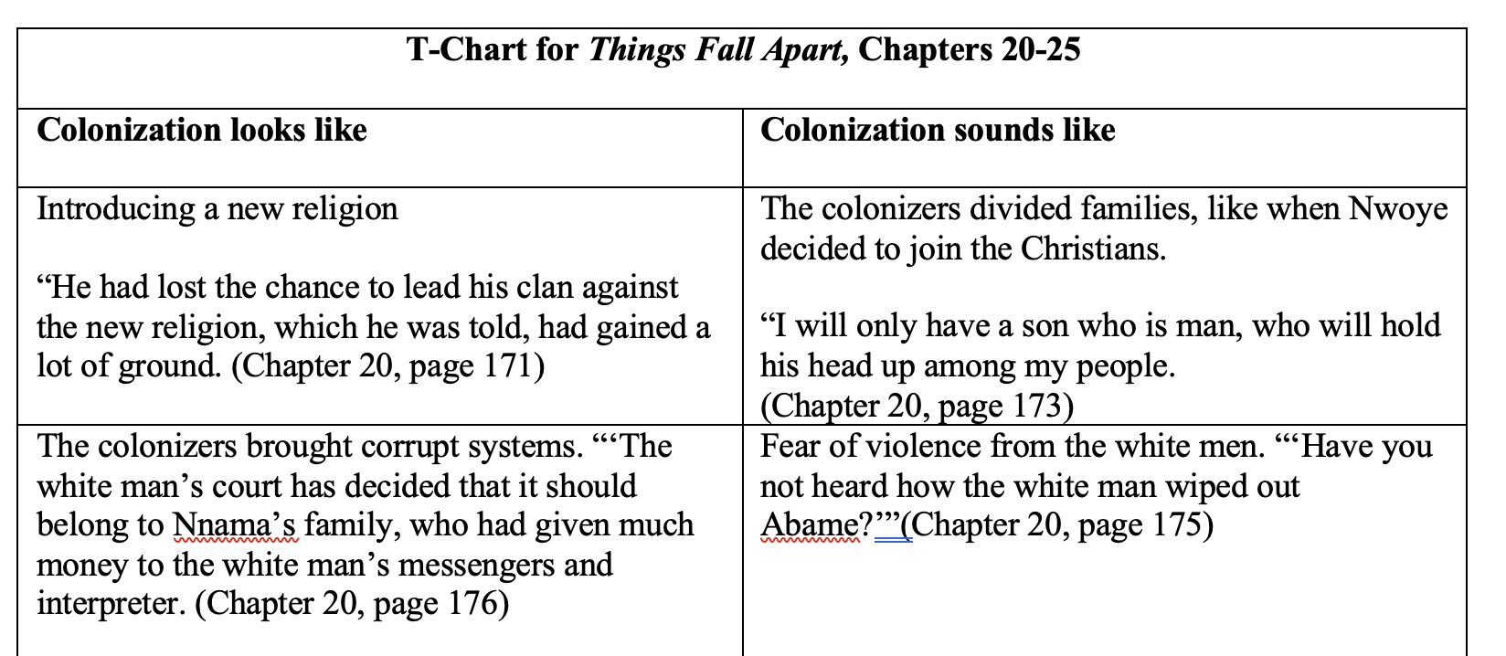
Strategy 4: T-Chart
Examine ideas side-by-side using “looks like” and “sounds like” (see handout)

Slide 9
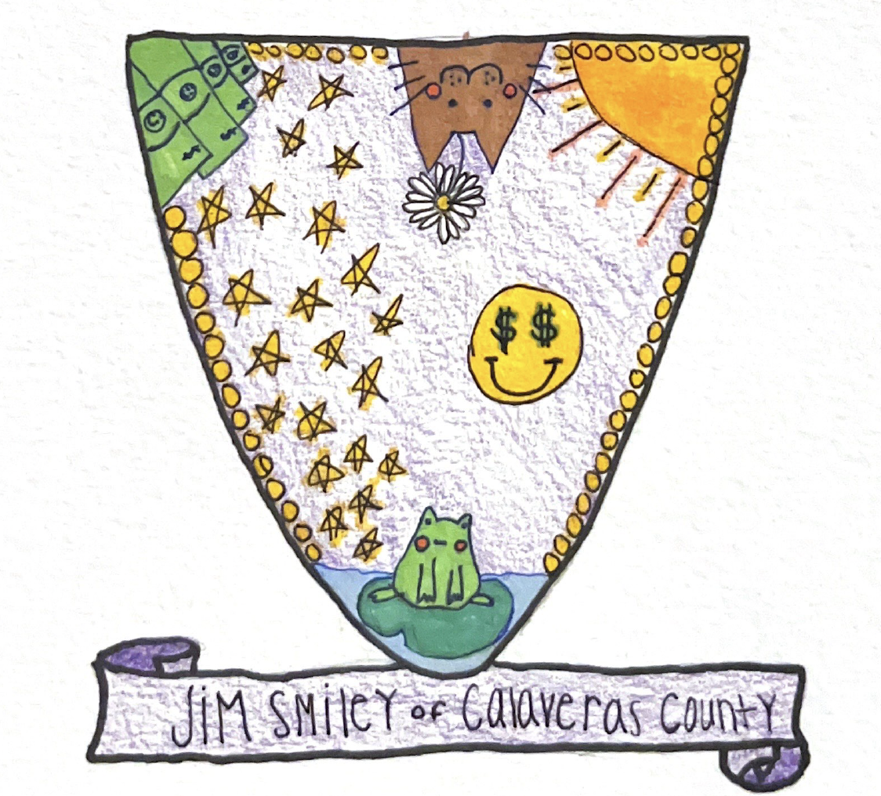
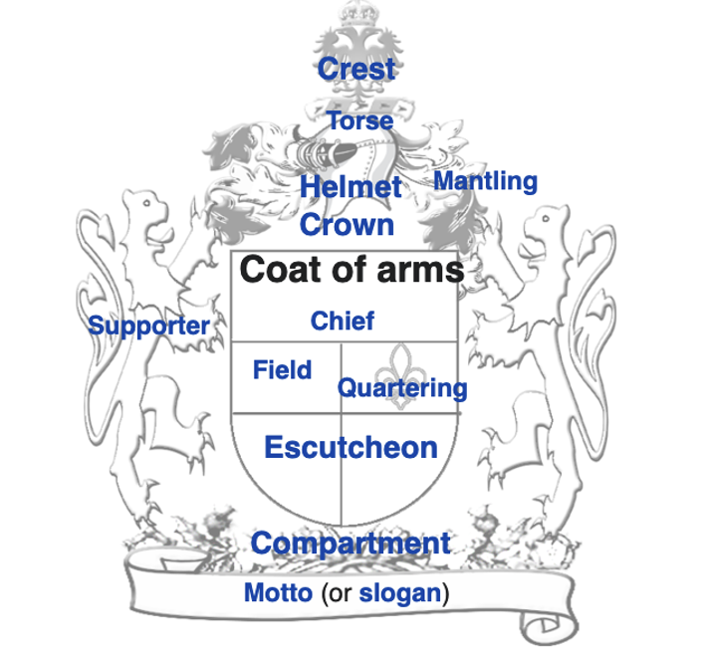
Strategy 5: Coat of Arms
Purpose—use symbolic thinking when looking at a text
Three parts:
Writing Frames
Visual Coat of Arms
Short paper explaining symbols
(you can make this optional if you want to keep the assignment shorter)
(see handout)

Slide 10
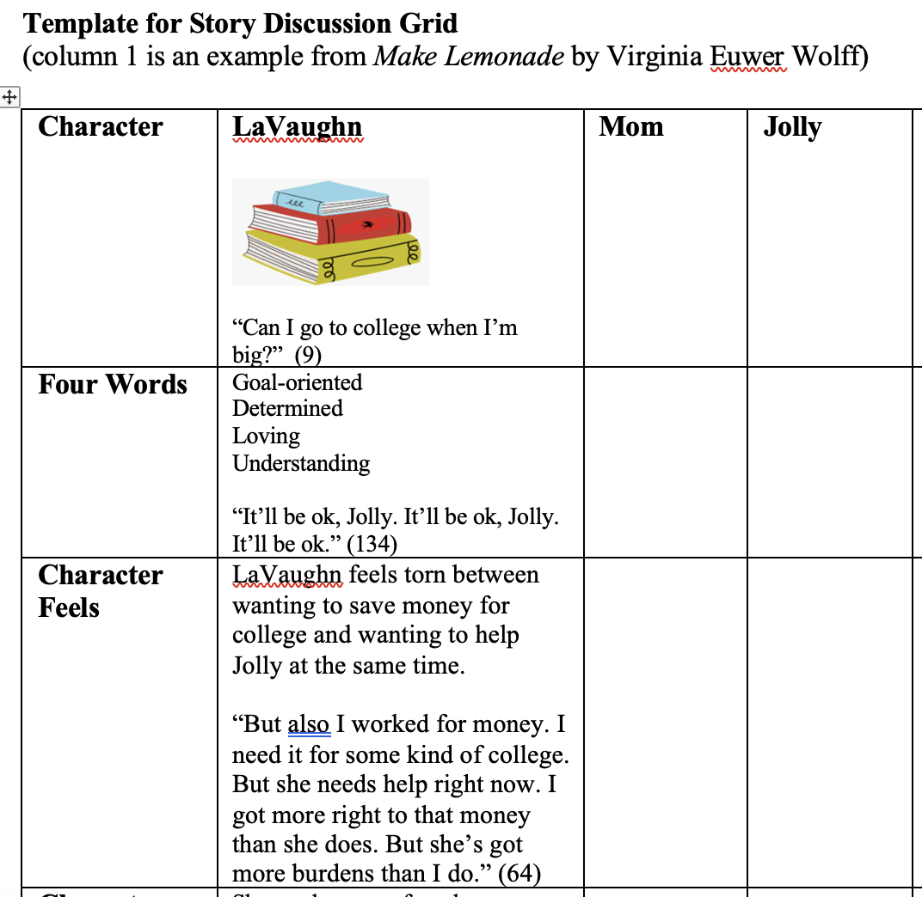
Strategy 6: Story Discussion Grid
Purpose—helps students review the text and focuses their attention on how authors develop characters whose actions and relationships are believable.
Column Row Labels
Character
Four Word Describing Character
Character Feels
Character Needs
Character Fears
Additional Guidelines
One quote in each row (stay rooted in the text)
Symbol to represent character (help students think symbolically)
Additional pictures optional (creativity; aesthetics)
Related Writing Assignment—3 questions (see handout)
Can omit this if you want the preparatory assignment to be shorter

Slide 11
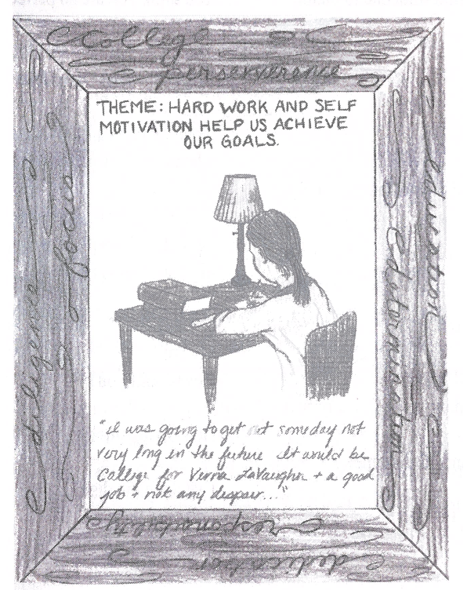
Strategy 7: Story Portrait
Purpose—to help students focus on the main point of a book (or other reading) and represent their understanding in a one-page graphic design that resembles a picture or portrait.
Instructions and Components—see handout

Slide 12


Final word
Engage students every class.
Help them build practices necessary for being effective teachers by regularly having them prepare in advance of every class.
Grade the prep work—can be simple but shows what they do counts.
Keep the classroom a place of motivation and encouragement for staying engaged and showing ownership of learning.
Linda J. Rice
RiceL2@ohio.edu

Slide 13

Discussion
What strategies do you use to help ensure students show ownership for learning?
What strategies do you use to hold students accountable for coming to class prepared on a regular basis?

